Slide 1

8th Grade Math: Pre-Algebra
Unit 12, Lesson 7 Evaluating Expressions with Radicals Volume 2, pg. 246

Slide 2


Benchmark
MA.8.NSO.1.7
Solve multi-step mathematical and real-world problems involving the order of operations with rational numbers, including exponents and radicals.
volume 2, pg. 246

Slide 3
Integrated Mathematical Thinking and Reasoning Standards
MA.K12.MTR.1.1 Actively participate in effortful learning both individually and collectively.
MA.K12.MTR.3.1 Complete tasks with mathematical fluency.
MA.K12.MTR.4.1 Engage in discussions that reflect on the mathematical thinking of self and others.
MA.K12.MTR.6.1 Assess the reasonableness of solutions.
volume 2, pg. 246

Slide 4

Learning Target
I can solve problems involving the order of operations with rational numbers, including exponents and radicals.
volume 2, pg. 246

Slide 5

Warm-Up
volume 2, pg. 247

Slide 6
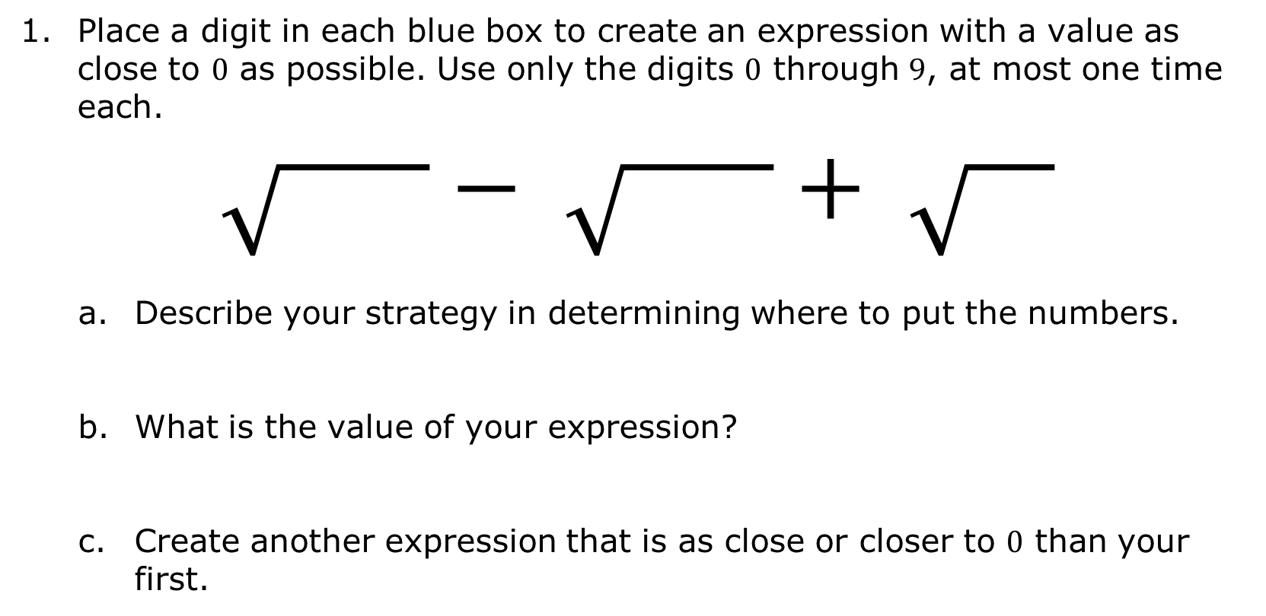
12.7.1 Warm-Up: Square Root Expression
Place a digit in each blue box to create an expression with a value as close to $0$ as possible. Use only the digits $0$ through $9$, at most one time each.
$$\sqrt{ }− \sqrt{ }+ \sqrt{ }$$
Describe your strategy in determining where to put the numbers.
What is the value of your expression?
Create another expression that is as close or closer to $0$ than your first.
volume 2, pg. 247

Slide 7

Refresher
volume 2, pg. 247

Slide 8

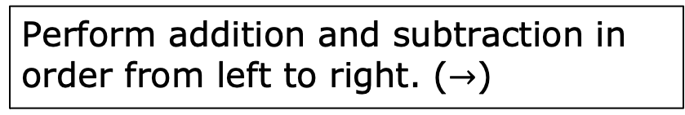
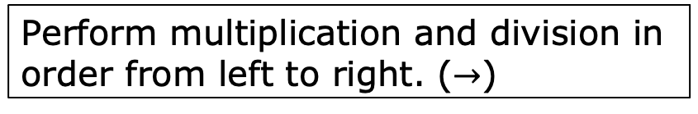
12.7.2 Refresher: Order of Operations
Recall that the order of operations is an agreed-upon set of rules for how to evaluate an expression.
Work with your partner to number each operation so that the operations are in the correct order.
Perform multiplication and division in order from left to right. ($→$)
Evaluate expressions with exponents.
Perform operations inside grouping symbols.
Perform addition and subtraction in order from left to right. ($→$)
volume 2, pg. 247

Slide 9
Based on what you have learned about radicals, discuss with your partner where you think evaluating radicals falls within the order of operations. Then, write a summary of your discussion.
volume 2, pg. 247

Slide 10

Guided Instruction
volume 2, pg. 248

Slide 11
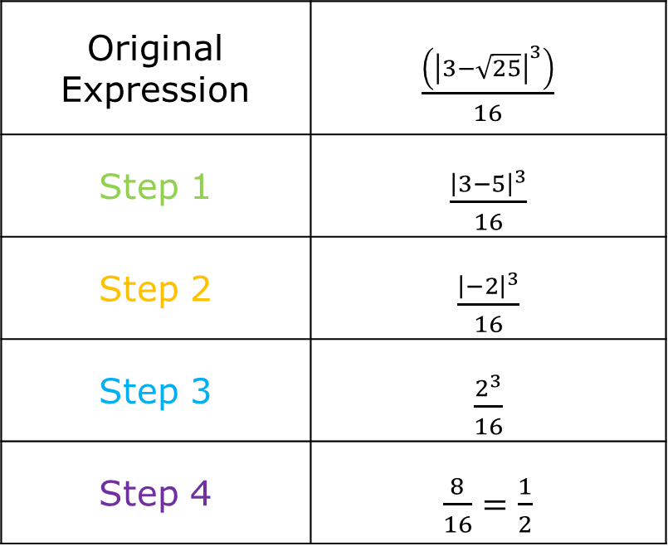
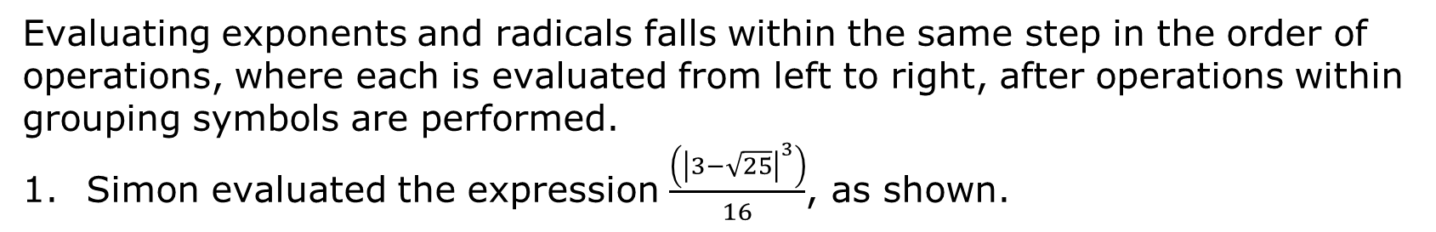
12.7.3 Guided Instruction: Evaluating Expressions with Radicals
Evaluating exponents and radicals falls within the same step in the order of operations, where each is evaluated from left to right, after operations within grouping symbols are performed.
Simon evaluated the expression $\frac{\left({\left|3−\sqrt{25}\right|}^{3}\right)}{16}$, as shown.
Original Expression | $\frac{\left({\left|3−\sqrt{25}\right|}^{3}\right)}{16}$
Step 1 | $\frac{{\left|3−5\right|}^{3}}{16}$
Step 2 | $\frac{{\left|−2\right|}^{3}}{16}$
Step 3 | $\frac{2^{3}}{16}$
Step 4 | $\frac{8}{16}=\frac{1}{2}$
volume 2, pg. 248

Slide 12
With your partner, discuss the steps Simon took to find the value of the expression.
Which grouping symbols are used in the expression?
volume 2, pg. 248

Slide 13

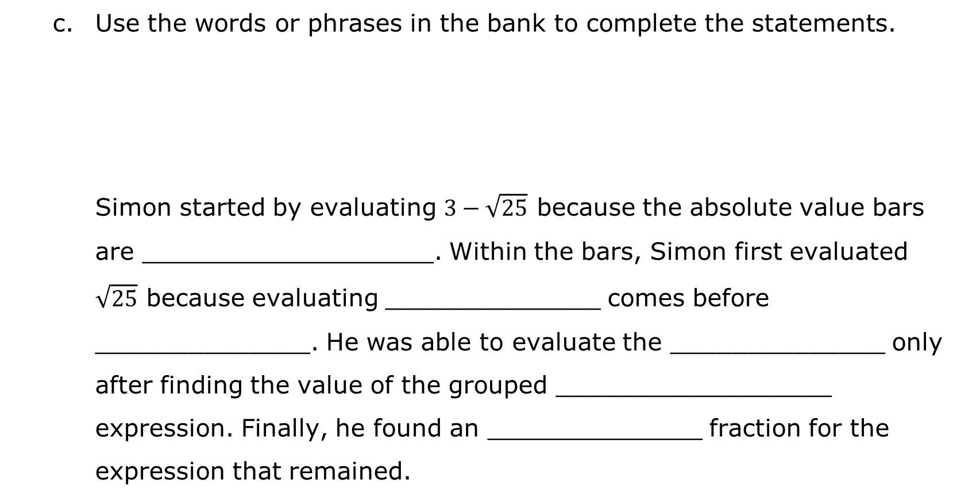
Use the words or phrases in the bank to complete the statements.
Simon started by evaluating $3−\sqrt{25}$ because the absolute value bars are ___________________. Within the bars, Simon first evaluated $\sqrt{25}$ because evaluating ______________ comes before ______________. He was able to evaluate the ______________ only after finding the value of the grouped __________________ expression. Finally, he found an ______________ fraction for the expression that remained.
volume 2, pg. 248

Slide 14
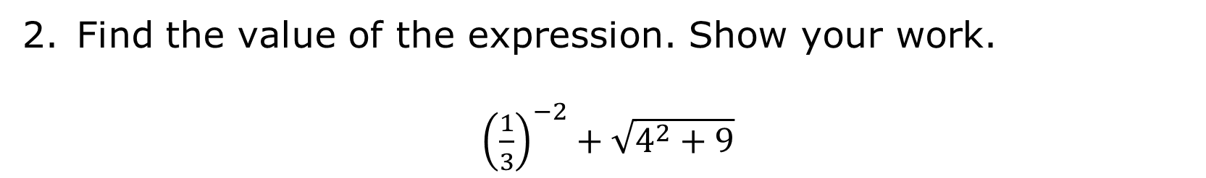
Find the value of the expression. Show your work.
${\left(\frac{1}{3}\right)}^{−2}+\sqrt{4^{2}+9}$
volume 2, pg. 248

Slide 15
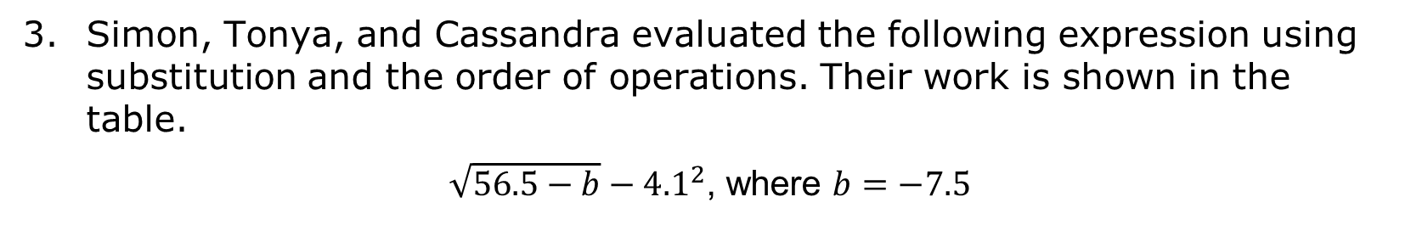
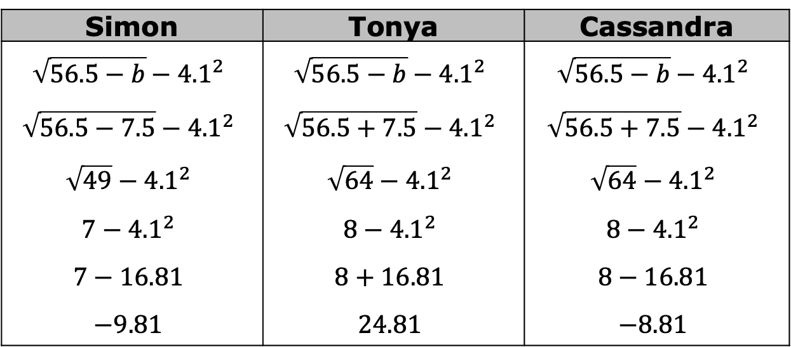
Simon, Tonya, and Cassandra evaluated the following expression using substitution and the order of operations. Their work is shown in the table.
$\sqrt{56.5−b}−{4.1}^{2}$, where $b=−7.5$
Simon | Tonya | Cassandra
$$\sqrt{56.5−b}−{4.1}^{2}$$ $$\sqrt{56.5−7.5}−{4.1}^{2}$$ $$\sqrt{49}−{4.1}^{2}$$ $$7−{4.1}^{2}$$ $$7−16.81$$ $$−9.81$$ | $$\sqrt{56.5−b}−{4.1}^{2}$$ $$\sqrt{56.5+7.5}−{4.1}^{2}$$ $$\sqrt{64}−{4.1}^{2}$$ $$8−{4.1}^{2}$$ $$8+16.81$$ $$24.81$$ | $$\sqrt{56.5−b}−{4.1}^{2}$$ $$\sqrt{56.5+7.5}−{4.1}^{2}$$ $$\sqrt{64}−{4.1}^{2}$$ $$8−{4.1}^{2}$$ $$8−16.81$$ $$−8.81$$
volume 2, pg. 249

Slide 16
Discuss each student’s work with your partner.
Circle the steps where you notice differences in the students’ work.
Which student correctly evaluated the expression?
volume 2, pg. 249

Slide 17
Complete the table to describe the error(s) each of the other two students made.
Student’s Name
Error(s) Made When Evaluating
volume 2, pg. 249

Slide 18

Guided Practice
volume 2, pg. 250

Slide 19


12.7.4 Guided Practice: Evaluating Expressions with Radicals
Find the value of the expression. Show your work.
$\frac{18 − 2 ∙ \sqrt{121}}{2^{3}}$
Find the value of the expression $\frac{6.2+\sqrt[3]{z}}{12}$, where $z=−27$.
volume 2, pg. 250

Slide 20

Your Turn
volume 2, pg. 250

Slide 21

12.7.5 Your Turn!
Find the value of each expression. Show your work.
$\frac{5 ∙ 3^{4}}{−\sqrt{225}}$
$\sqrt[3]{100−6^{2}}$
$\left|4^{−1}+\sqrt[3]{\frac{1}{8}}\right|$
$\frac{\sqrt{81} − w^{2}}{9}+25$ where $w=−4$
volume 2, pg. 250

Slide 22

Wrap-Up
volume 2, pg. 251

Slide 23
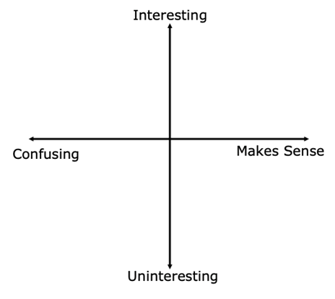
12.7.6 Wrap-Up: Reflection
Plot a point on the grid to indicate your level of interest and how you feel about today’s learning target.
I can solve problems involving the order of operations with rational numbers, including exponents and radicals.
volume 2, pg. 251

Slide 24
Write one question you still have about this learning target after today’s lesson.
volume 2, pg. 251

